Slide 1
Unit 1
OBJECT ORIENTED PROGRAMMING USING C++

Slide 2
In this unit..
The Origins Of C++
What Is Object Oriented Programming
Some C++ Fundamentals.
General Form of a C++ Program
Introduction to Classes and objects.
Structures and classes are related.
Unions and classes are related.
Scope resolution operator

Slide 3
Before we start !
What is procedure oriented programming?
Some flaws of procedure oriented programming!

Slide 4
Procedure oriented Vs Object oriented
What is Procedure oriented?
Best example of procedure or function oriented programming language is C.
In C, total program is divided into subprograms or sub routines , which is technically called functions.

Slide 5
Consider for example
a C program with 100 lines of code.
Assume after compilation we get error
To identify in which line error is, we need to check line by line.
Suppose we need to execute specific 10 lines. Since these 10 lines are not separated from program, we need to execute all 100 lines.
Now we will divide these 100 lines into small pieces. Assume 20 lines each pieces.

Slide 6
These pieces are called Functions.
A function is a small program which is used to do a particular task.
Now it is easy to identify where exactly the error is.
Ex: Printf is a function which will perform printing / display task.
Entire C program is function oriented. So C is a function oriented programming language.

Slide 7
Advantages of function oriented
Easy to identify errors.
When program is small, performance is increased.
Major advantage of function is write once use many times, which is called reusability.
Then what is problem with functions?

Slide 8
Suppose there is a main() function and it contains 3 sub functions.
Int a, b; // global variables
main()
{
Sum();
Mul();
Div();
}

Slide 9
When data is global, any function can access it.
Data is freely moving around the program. We will not know which function is using data.
So data is not protected.
To avoid this problem, to provide more security to data, application of OOP is introduced.
In OO approach also, program is divided into data and functions, but they are combined into single unit called objects.

Slide 10
Combining Data and Behaviour
Old approach OO approach
Caller of an operation need not consider how many implementations exist.
Function
Function
Data
Data
Function
Function
Function

Slide 11
Object oriented program:
In C programming language, data are separately stored and functions are separately stored and all functions have access to global variables.
In OO programming, variable and functions together placed inside the single unit called object.
The object functions are accessed only with the member function or operation associated with that object only( and outer are not allowed).
Here data is secured, this concept is called data hiding.

Slide 12
What is Object Oriented Programming?
Object-oriented programming (OOP) is a programming language model organized around objects rather than "actions" and data rather than logic.
Programming paradigm that views a computer program as a combination of data structures (called objects) which can exchange information in a standardized manner, and can be combined with one another as modules or blocks.
Each object is independent (can be changed without affecting other blocks), can run (execute) by itself, and can be interlocked with other objects.

Slide 13
Some of the striking features of OOPs are:
Emphasis is on data rather than procedure.
Programs are divided into what are known as objects.
Data structures are designed such that they characterize the objects.
Functions that operate on the data of an object are tied together in the data structure.
Data is hidden and cannot be accessed by external functions.
Objects may communicate with each other through functions.
New data and functions can be easily added whenever necessary.
Follows bottom-up approach in program design.

Slide 14
OO Features
The main feature in OO is Class, then Object, data hiding, encapsulation, inheritance, polymorphism, message communication etc. there are several features.
Now let us start with Class.
What is a Class?
Class is extension of Structures.
Since it is extension of structures, before going to class let us briefly discuss about structures.

Slide 15
Class
In C, Structures means collection of heterogeneous variables.
i.e., structures allows to store different types of variables at one place under one name.
A structure is a user defined data type.
In C, we use both primitive and derived data types.
Primitive like int , float, char
Derived like arrays, pointer, function.
We are able to declare both primitive and derived data type at one place using structure.

Slide 16
For ex: let us consider a student data
Void main() Struct Stu
{ {
Int id, m[3]; int id, m[3];
Char name[20]; char name[20];
} }
s1, s2,…sn // structure
variables.
Using these structure variables we can access structure data. i.e. s1.id, s2.name etc.
With these structure variables, memory is allocated in stack

Slide 17
Disadvantage of Structure
In C, main disadvantage of structure is, data members are by default Public. i.e., structure data are accessible anywhere through out the program through structure variables.
To avoid this problem, the concept of class is introduced.

Slide 18
Structure in C++
In C++ also we have structures.
What is difference between
C structure and C++ structure?

Slide 19
In C, inside structure we are able to declare only structure members. i.e., variables only
Where as in C++, inside structure we can declare structure members along with member functions . i.e., both variables and functions.
But in C++ also structure data are public.
So introduction of Class concept came into existence.

Slide 20
In class, data is divided into public, private & protected members.
Also in C++ structure, we have private, public and protected but, we are not able to design complex program/ application using these structures. But this is possible with class since class supports inheritance concept.
Now let us start Class concept.

Slide 21
What is a Class?
Class is an extension of C structures.
In C++ Structure, the data is accessed by member functions as well as outside member functions. So it is not secured.
In C++ there is a rule:
Private data of a class should be accessed with member function of same class.
For example;
Class Student
{ Private/Public/Protected:
data members;
member functions():
};

Slide 22
Consider
Class Stu
{
Private: // in C++, by default class data are private.
int id; so key feature data hiding can be achieved
char name[20]; through private access specifier.
Public:
void get()
{
cout
cin>>id, name;
}
}
User is able to design secured application using class concept.

Slide 23
So, we can define class as
Class is a collection of data members and member functions.
In class, data and member functions are associated together.
Here comes the another feature of OOPs, encapsulation.
Encapsulation is binding the data and associated function together into a sing unit called Class.

Slide 24
We can also define Class is a user defined data type.
How?
To access structure members we should declare structure variables, then only memory is allocated in stack.
Similarly, in Class also, to access the data members of class, memory need to be allocated and this memory will be allocated when objects are created.

Slide 25
So we can say, object is a variable of type class and objects are class variables.
Example:
void main()
{
Stu st; // st is an object, here memory is
allocated to data member of object
st.get(); // calling
}
We can also define class as:
Class is a blue print to construct object and object is the physical representation of class.
When object is created then only memory is allocated. Which means class never take memory.
Therefore, object is physical and class is logical.
Class is blue print and objects are copies or instance of class.

Slide 26
Data Abstraction and Encapsulation
The wrapping up of data and function into a single unit ( called class) is known as encapsulation.
Data is not accessible to the outside world, only those function which are wrapped in the class can access it.
These functions provide the interface between the object’s data and the program.
This insulation of the data from direct access by the program is called data hiding or information hiding.

Slide 27
Encapsulation
Hide implementation from clients
Clients depend on interface
How does an object encapsulate?
What does it encapsulate?
Improves Resiliency
Notes:
Encapsulation is putting the “databits” and operations that manipulate them in the same place. Encapsulation DISALLOWS direct manipulation of things that have been encapsulated without utilising the supplied interface.
Another example - the accelerator on a car. You put your foot down and car goes faster - this works on most cars, and you don’t worry about the cables, electronics, engine, etc.

Slide 28
Abstraction : refers to the act of representing essential features without including the background details or explanations.
Salesperson
Not saying Which salesperson – just a salesperson in general!!!
Product
Customer
“It emphasis on only essential things in application while ignoring rest of the details”
Notes:
Discuss what makes a good abstraction with the students:
Concise,
Represents a single coherent concept,
etc.

Slide 29
Classes use the concept of abstraction and are defined as a list of abstract attributes such as size, weight and cost and functions to operate on these attributes.
They encapsulate all the essential properties of the objects that are to be created.
The attributes are sometimes called as data members and functions that operate on these data are called methods or member functions.
Since the classes use the concept of data abstraction, they are known as Abstract Data Types (ADT)

Slide 30
Inheritance
Inheritance is the process by which objects of one class acquire the properties of objects of another class.
It supports the concept of hierarchical classification.
For eg:, the transportation ‘Bus’ is a part of the class ‘Land vehicle’ which is again part of the class ‘Vehicle’.
The principle behind this sort of division is that each derived class shares common characteristics with the class from which it is derived.
Also, the concept of inheritance provide the idea of reusability. This means that we can add additional features to an existing class without modifying it.

Slide 31
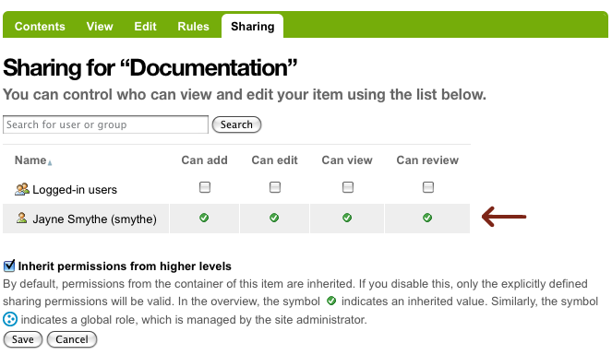
Inheritance support Sharing
OO development not only lets you share information within an application, but also offers the prospect of reusing designs and code on future projects.

Slide 32
Polymorphism
Polymorphism is another important OOP concept.
Polymorphism, a Greek term, means the ability to take more than one form.
An operation may exhibit different behaviors in different instances. The behavior depends upon the types of data used in the operation.
For ex: consider the operation of addition. For two numbers, the operation will generate a sum. If the operands are strings, then the operation would produce a third string by concatenation.
This process of making an operatior to exhibit different behaviors in different instances is known as operator overloading.

Slide 33
A single function name can be used to handle different numbers and different types of arguments.
This is similar to a particular word having several different meanings depending on the context.
Using a single function name to perform different types of tasks is known as function overloading.

Slide 34
Origin of C++

Slide 35
Origin of C++
C++ Development started in 1979.
During the creation of Ph.D. thesis, Bjarne Stroustrup worked with language called Simula.
Simula was first language to support object-oriented programming paradigm.
Bjarne Stroustrup identified that this OOP features can be included in the software development.

Slide 36
Origin of C++...
After that Bjarne Stroustrup started working on the C language and added more extra OOP features to the classic C.
He added features in such a fashion that the basic flavour of C remains unaffected.
C++ includes some add-on features such as classes, basic inheritance, in-lining, default function arguments, and strong type checking

Slide 37
Fundamentals of C++

Slide 38
C++ Compilers
Visual C++ - Microsoft
Turbo C++ - Borland
GCC - GNU Project
Borland C++ - Borland
Intel C++ Complier – Intel
Hp Ac++ - Hewlet Packard

Slide 39
Compliers that we will use
GCC – GCC is an Acronym for "GNU Compiler Collection".
It is a collection of compilers for C, C++, Fortran and other tools.
g++ hello.cpp -o hello
./hello

Slide 40
Sample C++ program
Header files
Namespace :
A namespace is a declarative region that provides a scope to the identifiers (the names of types, functions, variables, etc) inside it.
Namespaces are used to organize code into logical groups and to prevent name collisions that can occur especially when your code base includes multiple libraries.
int main
return

Slide 41
Sample C++ Program
#include <iostream>
using namespace std;
// A C++ program begins at main().
int main()
{
cout << "C++ is power programming.";
return 0;
}
To execute the program g++ filename.cpp -o Outputfilename

Slide 42
I/O Operators in C++
C++ uses a convenient abstraction called streams to perform input and output operations in sequential media such as the screen, the keyboard or a file.
A stream is an entity where a program can either insert or extract characters to/from.

Slide 43
I/O Operates in C++
The standard library defines a handful of stream objects that can be used to access what are considered the standard sources and destinations of characters by the environment where the program runs:
cin | standard input stream
cout | standard output stream
cerr | standard error (output) stream
clog | standard logging (output) stream

Slide 44
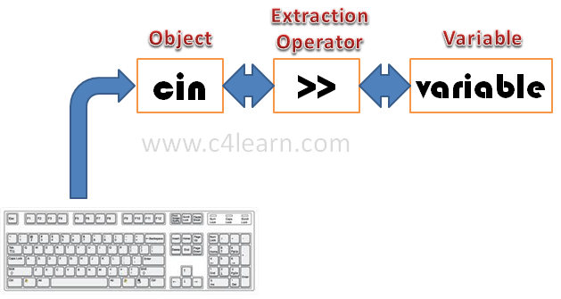
cin
The predefined object cin is an instance of istream class.
The cin object is said to be attached to the standard input device, which usually is the keyboard.

Slide 45
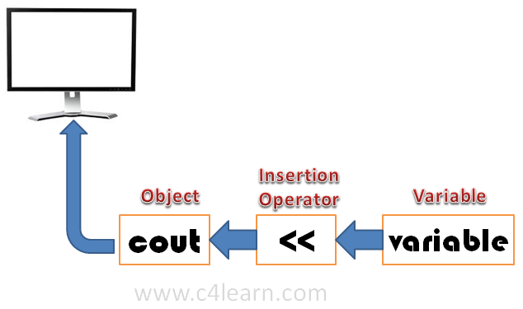
cout
The predefined object cout is an instance of ostream class.
The cout object is said to be "connected to" the standard output device, which usually is the display screen.

Slide 46
Variables
A variable is a named location in memory that is used to hold a value that may be modified by the program.
All variables must be declared before the can be used.
Syntax:
type variable_list;
Here type is a valid data type plus any modifiers
Variable_list – may consists of one or more identifier names seperated by commas.
Ex:
int i, j, k;
Short int si;
Unsigned int ui;
Double balance, profit, loss;

Slide 47
Scope of a Variable
A scope is a region of the program and broadly speaking there are three places, where variables can be declared:
Inside a function or a block which is called local variables,
In the definition of function parameters which is called formal parameters.
Outside of all functions which is called global variables.

Slide 48
Local Variables
Variables that are declared inside a function or block are local variables.
They can be used only by statements that are inside that function or block of code.
Local variables are not known to functions outside their own

Slide 49
Example
void func1(void)
{
int x;
x=10;
}
void func2(void)
{
int x;
X=-199;
}

Slide 50
Global Variables
Global variables are defined outside of all the functions, usually on top of the program.
The global variables will hold their value throughout the life-time of your program.
A global variable is available for use throughout your entire program after its declaration.

Slide 51
Example
int count; // count is global
Void func1(void);
Void func2(void);
int main(void)
count=100;
func1();
return 0;
}
void func1(void) void func2(void)
{ {
temp=count; ìnt count;
func2(); for(count=1; count<10; count++)
cout<<“count is %d”<<count; putchar(1,1);
} }

Slide 52
Primitive Built-in DataTypes:
C++ offer the programmer a rich assortment of built-in as well as user defined data types.
Char
Int
Float
Double
Void
Bool

Slide 53
Modifiers
The basic data types may have several modifier preceding them to serve the needs of various situations. The modifiers are:
Signed
unsigned
short
Long
We can apply the modifiers –
signed, short, long & unsigned to Integer base type.
We may apply long to double type.

Slide 54
The bool Data Type
Along with Int, char, float , double data types another data type is bool.
bool has been added to hold a boolean value, true or false. The value true or false have been added as keywords to the C++ language. Bool type variable can be declared as
Ex:
bool b1;
b1= true;
bool b2 = false;

Slide 55
Void: the type void was introduced in ANSI C.
The normal uses of void are:
To specify the return type of a function when it is not returning any value.
To indicate an empty argument list to a function.
Ex: void function1(void);

Slide 56
Old-style Vs Modern C++
C++ underwent an extensive evolutionary process during its development and standardization.
As a result, there are really two versions of C++.
The first is the traditional version i.e., based upon Bjarne Stroustrup’s original design.
Second is Standard C++, which was created by stroustrup and the ANSI/ISO standardization committee.
The key differences between old-style and modern code involve two features:
New style headers and
The namespace statement .

Slide 57
/* in old-style C++ program. */
#include <iostream.h>
int main()
{
return 0;
}
/*in modern style C++ program*/
#include <iostream>
Using namespace std;
Int main()
{
return 0;
}

Slide 58
The New C++ headers
New style headers are not filenames, they do not have a .h extension because C++ include the entire C function library.
Here are some of the new-style headers supported by Standard C++
<iostream> <fstream> <vector> <string>
Namespaces
When you include a new-style header in your program, the contents of that header are contained in the std namespace.
A namespace is simply a declarative region.
Purpose is to localize the names of identifiers to avoid name collisions.
Elements declared in one namespace are separate from elements declared in another.
Names of C++ library functions, etc are put into the global namespace ( as they are in C)

Slide 59
Storage Classes
A storage class defines the scope (visibility) and life-time of variables and/or functions within a C++ Program.
These specifiers precede the type that they modify.
There are following storage classes, which can be used in a C++ Program
auto
register
static
extern
mutable

Slide 60
The auto and register Storage Class
The auto storage class is the default storage class for all local variables.
The register storage class is used to define local variables that should be stored in a register instead of RAM.

Slide 61
The Static Storage Class
The static storage class instructs the compiler to keep a local variable in existence during the life-time of the program instead of creating and destroying it each time it comes into and goes out of scope.
Therefore, making local variables static, allows them to maintain their values between function calls.

Slide 62
Mutable in C++
Objects of class declared as const cannot modify their data members. To override this rule for a some purpose, mutable can be used on such data members.
Using mutable storage specifier, data members of const objects can be modified to any new value.
Applicability of mutable:
Mutable is applicable only to data members and not to variables.
Data members cannot be reference
Data member cannot be static
Data member cannot be const

Slide 63
Conditonal Statements
If
If.. else
Else if
switch

Slide 64
Looping Statements
While
Do-while
For

Slide 65
Classes and Objects in C++

Slide 66
C++ Class
A class is the collection of related data and function under a single name.
A C++ program can have any number of classes.
Defining the Class in C++
class class_name
{
access_specifier_1:
member1;
access_specifier_2:
member2;
...
} object_names;

Slide 67
Defining a Class in C++
Class_name is a valid identifier for the class,
Object_names is an optional list of names for objects of this class.
The body of the declaration can contain members, which can either be data or function declarations, and optionally access specifiers.

Slide 68
Access Specifiers
An access specifier is one of the following three keywords: private, public or protected.
These specifiers modify the access rights for the members that follow them.
1. Private: Private member defines that the members or methods can be accessed within the same class only.
2. Public: Public member defines that the variable or methods can be accessed at any where within
the project.
3. Protected: Protected member can be accessed to the class which is inherited by other class.

Slide 69
WAP
Write a program to create a class student with the following:
Data members: name , rollno, age, cgpa
Two functions : enter and display to accept the details and display them respectively.
Create object of class student and call the enter and display methods respectively.

Slide 70
Classes and Structures Are Related
Classes and Structure are very similar. The only difference is that by default the members of a class are private while, by default, the members of a struct are public.
According to the formal C++ syntax, a struct defines a class type.
The C++ struct can include data and the code that manipulates that data in the same way that a class can.

Slide 71
Unions and Classes Are Related
A union is essentially a structure in which all elements are stored in the same location.
Like a structure, union members are public by default.
A union can contain constructor and destructor functions as well as member and friend functions.
There are several restrictions that must be observed when you use C++ unions. They are:

Slide 72
1) A union cannot inherit any other classes of any type.
2) A union cannot be a base class.
3) A union cannot have virtual member functions.
4) No static variables can be members of a union.
5) A union cannot have as a member any object that overloads the = operator.

Slide 73
Scope Resolution Operator
Different program modules are written in various blocks.
Same variable name can be used in different blocks.
Scope of a variable extends from the point of declaration to the end of the block.
A variable declared inside a block is ‘local’ variable. Blocks in C++ are often nested.
The declaration of the inner block hides the declaration of same variable in outer block.
This means, within the inner block, the variable x will refer to the data object declared therein.
To access the global version of the variable, C++ provides scope resolution operator.

Slide 74
To access global variable that has same name as that of the local variable.
#include<iostream>
using namespace std;
int a=20;
int main()
{
int a=10; // local declaration of a;
cout<<a; // prints local variable a as 10.
cout<<(::a); // access global var ‘a’ using :: and it prints 20.
}

Slide 75
In C++, “::” operator is called scope resolution operator.
It is used for various purpose, such as:
To give body (definition) of the member function outside the class.
To access global variable that has same name as that of the local variable.
To resolve ambiguities during multiple inheritances.

Slide 76
End of Unit 1

